Slide 1




TOMASZ KAJETAN STAŃCZAK
TKSTANCZAK@NETHERMIND.IO

Slide 2





Slide 3
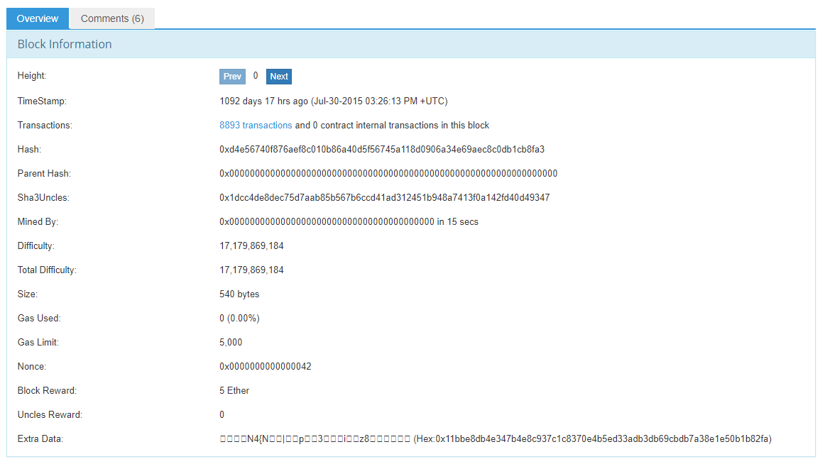
genesis block

Slide 4
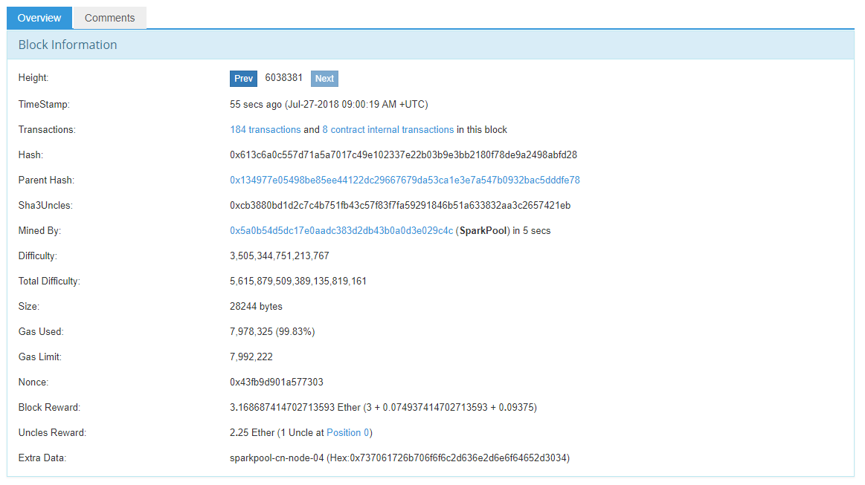
block

Slide 5
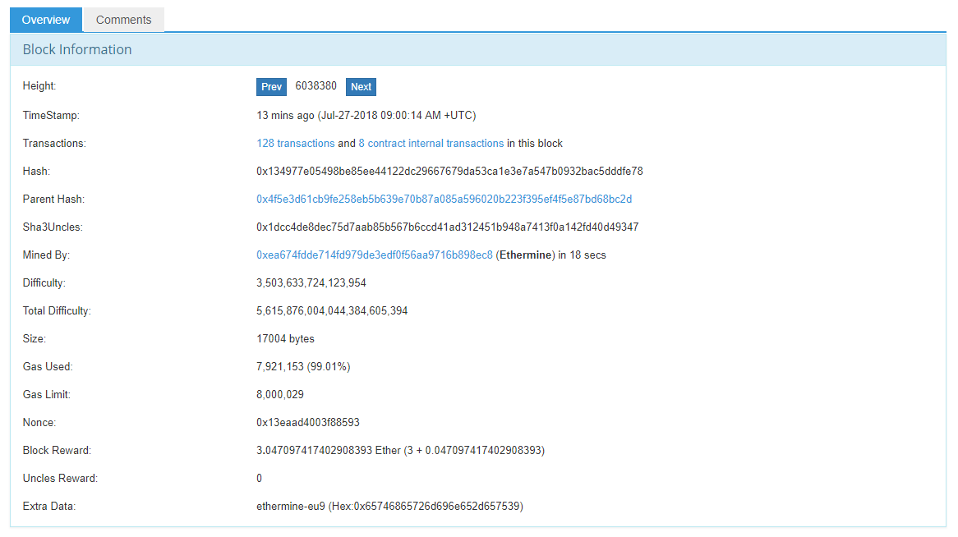
block parent

Slide 6

http://www.ghmhotels.com/ghmjourneys/balis-best-dances/

Slide 7
Keccak (pronounced [kɛtʃak], like “ketchak”)
32 bytes
0xc5d2460186f7233c927e7db2dcc703c0e500b653ca82273b7bfad8045d85a470
https://keccak.team/keccak_specs_summary.html

Slide 8
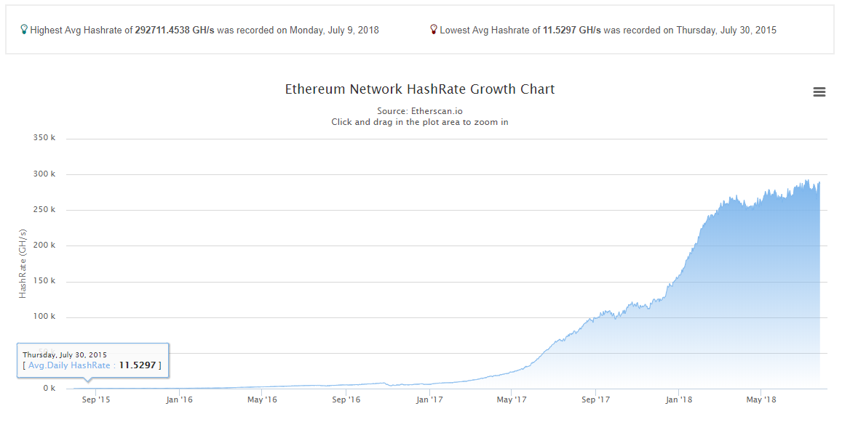
ethash

Slide 9
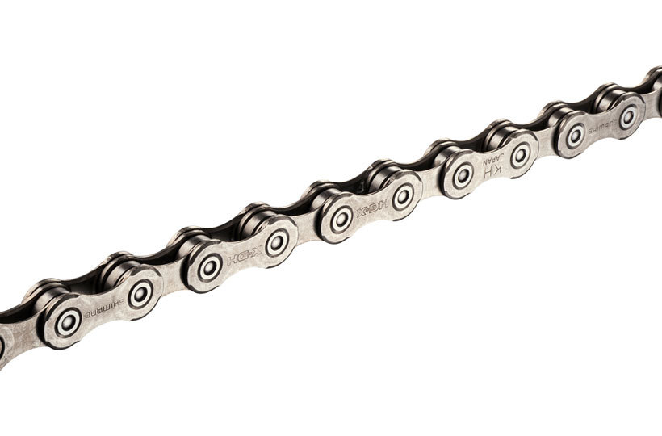
chain img src
https://www.evanscycles.com/shimano-hg95-10-speed-hg-x-chain-EV198182

Slide 10
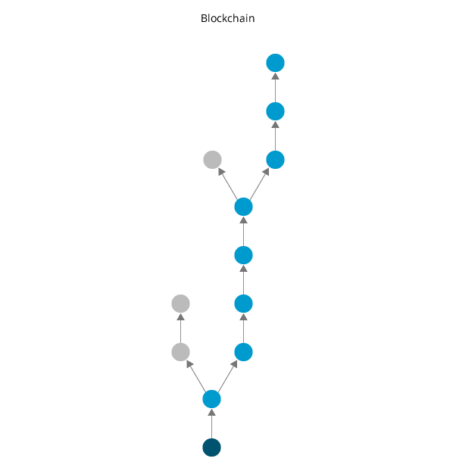
blockchain : block tree
reorganization
img src Andrii Shekhirev, MSc Finance, Stockholm School of Economics (2011)

Slide 11
discovery
nodeID : kademlia : v5
https://pdos.csail.mit.edu/~petar/papers/maymounkov-kademlia-lncs.pdf

Slide 12
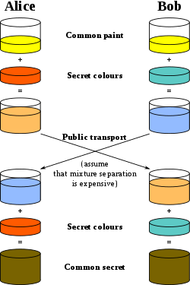
RLPx
handshake
(broken)
https://en.wikipedia.org/wiki/Diffie%E2%80%93Hellman_key_exchange

Slide 13
p2p
eth62, eth63
status : subprotocols
full sync : fast sync

Slide 14
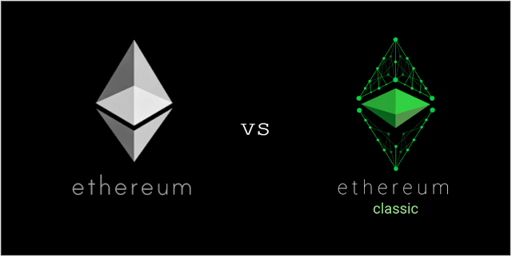

forks
0 000 000 Frontier
1 150 000 Homestead
1 920 000 DAO
2 463 000 Tangerine Whistle
2 675 000 Spurious Dragon
4 370 000 Byzantium
6 500 000 now
... Constantinople
The link below is the source of the image but do not visit the link for the information – I do not recommend it
https://steemit.com/ethereum/@self-steem/ethereum-eth-vs-ethereum-classic-tc

Slide 15
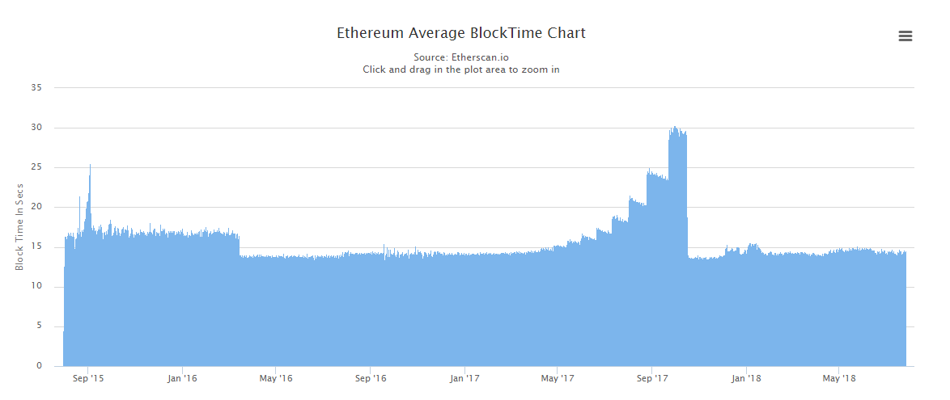
ice age
private BigInteger TimeBomb(IReleaseSpec spec, UInt256 blockNumber) { if (spec.IsEip1234Enabled) { blockNumber = blockNumber - UInt256.Min(blockNumber, 5000000); } else if (spec.IsEip649Enabled) { blockNumber = blockNumber - UInt256.Min(blockNumber, 3000000); } return blockNumber < 200000 ?
UInt256.Zero :
BigInteger.Pow(2, (int)(BigInteger.Divide(blockNumber, 100000) - 2)); }

Slide 16
private key
32 bytes (random, almost all valid)
0x|3a|10|76|bf|45|ab|87|71|2a|d6|4c|cb|3b|10|21|77|37|f7|fa|ac|bf|28|72|e8|8f|dd|9a|53|7d|8f|e2|66|

Slide 17
public key
64 bytes (or 65 bytes with 0x04)
3a1076bf45ab87712ad64ccb3b10217737f7faacbf2872e88fdd9a537d8fe266
0x3a1076bf45ab87712ad64ccb3b10217737f7faacbf2872e88fdd9a537d8fe266
0x|3a|10|76|bf|45|ab|87|71|2a|d6|4c|cb|3b|10|21|77|37|f7|fa|ac|bf|28|72|e8|8f|dd|9a|53|7d|8f|e2|66
|00000011 00001010| … |00000110 00000110|

Slide 18
secp256k1
Nethermind.Secp256k1.Test
building secp256k1 : Bouncy Castle
private key : public key
http://www.secg.org/sec1-v2.pdf
https://hackernoon.com/what-is-the-math-behind-elliptic-curve-cryptography-f61b25253da3
https://medium.com/@VitalikButerin/exploring-elliptic-curve-pairings-c73c1864e627

Slide 19
address
20 bytes
private Address ComputeAddress() { byte[] hash = Keccak.Compute(Bytes).Bytes; byte[] last160Bits = new byte[20]; Buffer.BlockCopy(hash, 12, last160Bits, 0, 20); return new Address(last160Bits); }

Slide 20
address
20 bytes
0x5a4eab120fb44eb6684e5e32785702ff45ea344d
(EIP-55) 0x5A4EAB120fB44eb6684E5e32785702FF45ea344D

Slide 21
EIP
Ethereum Improvement Proposal
https://github.com/ethereum/EIPs

Slide 22
account
address → nonce : balance : code hash : storage root

Slide 23
signing
public void Sign(PrivateKey privateKey, Transaction transaction, BigInteger blockNumber) { if(_logger.IsDebug) _logger.Debug($"Signing transaction: {transaction.Value} to {transaction.To}"); bool isEip155Enabled = _specProvider.GetSpec(blockNumber).IsEip155Enabled; Keccak hash = Keccak.Compute(Rlp.Encode(transaction, true, isEip155Enabled, _chainIdValue)); transaction.Signature = Sign(privateKey, hash); if (isEip155Enabled) { transaction.Signature.V = (byte)(transaction.Signature.V + 8 + 2 * _chainIdValue); } if(_logger.IsDebug) _logger.Debug("Transaction signed"); }

Slide 24
recovery
public Address RecoverAddress(Transaction transaction, BigInteger blockNumber) { bool isEip155Enabled = _specProvider.GetSpec(blockNumber).IsEip155Enabled; bool applyEip155 = isEip155Enabled && (transaction.Signature.V == _chainIdValue * 2 + 35 || transaction.Signature.V == _chainIdValue * 2 + 36); Keccak hash = Keccak.Compute(Rlp.Encode(transaction, true, applyEip155, _chainIdValue)); return RecoverAddress(transaction.Signature, hash); }
public Address RecoverAddress(Signature signature, Keccak message) { return RecoverPublicKey(signature, message)?.Address; }

Slide 25
RLP
value 0 -> 128
value lt 128 -> value
empty byte array -> 128
length 1 byte array -> first byte value
length lt 56 byte array -> (128 + length) + byte array
length gt 56 byte array -> (183 + length of serialized length) + (serialized length) + byte array

Slide 26
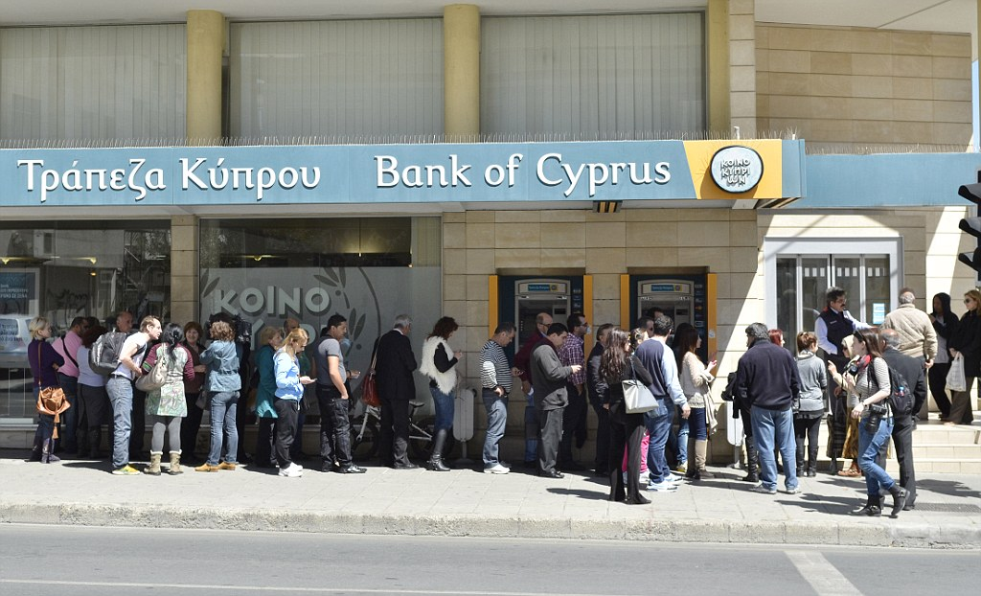
pending transactions
https://www.thisismoney.co.uk/money/news/article-2302515/Ernst--Young-Turmoil-Cyprus-timely-reminder-eurozone-crisis-far-over.html

Slide 27
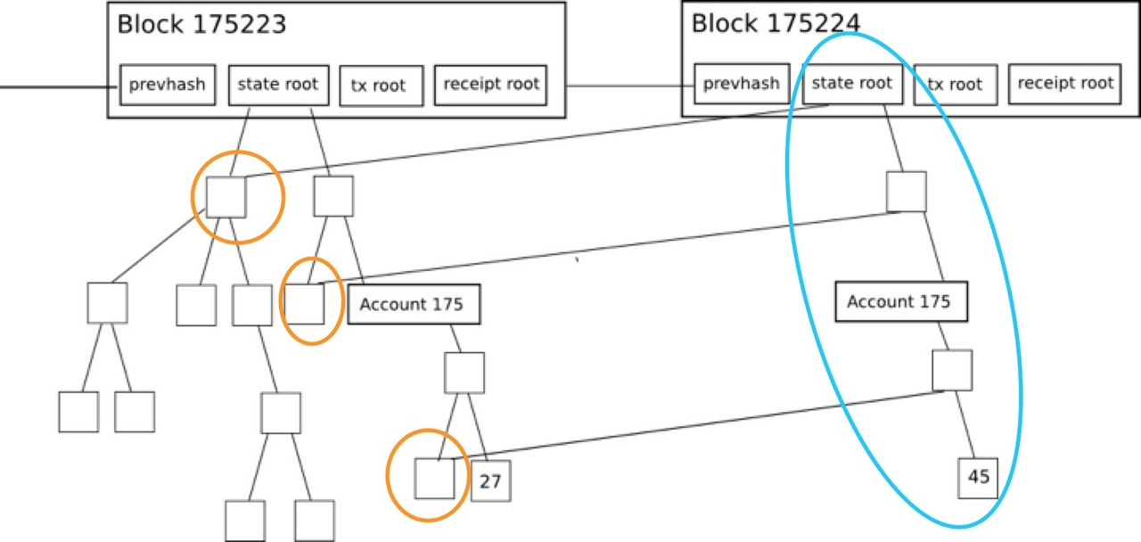
patricia tree
branch : extension : leaf
tree root
https://ethfans.org/toya/articles/588

Slide 28
DBs
RocksDB : LevelDB : SSD

Slide 29
account storage
int256 -> int256

Slide 30
pruning
full archive : fast sync

Slide 31
EVM

Slide 32
gas
gas cost : gas limit : gas price

Slide 33
int256

Slide 34
stack
stack size

Slide 35
memory
memory cost

Slide 36
call stack
env : stack : memory : return data : call depth

Slide 37
opcodes
arithmetic : bitwise : SHA3 : env : block : memory : flow : stack : logs : calls

Slide 38
precompiles
private void InitializePrecompiledContracts() { _precompiles = new Dictionary<Int256, IPrecompiledContract> { [1] = EcRecoverPrecompiledContract.Instance, [2] = Sha256PrecompiledContract.Instance, [3] = Ripemd160PrecompiledContract.Instance, [4] = IdentityPrecompiledContract.Instance, [5] = Bn128AddPrecompiledContract.Instance, [6] = Bn128MulPrecompiledContract.Instance, [7] = Bn128PairingPrecompiledContract.Instance, [8] = ModExpPrecompiledContract.Instance }; }

Slide 39
internal calls
CREATE : CALL : CALLCODE : DELEGATECALL : STATICCALL

Slide 40
contract creation
init : code deposit

Slide 41
exceptions
out of gas : stack overflow : stack underflow : bad instruction : invalid jump : static call violation

Slide 42
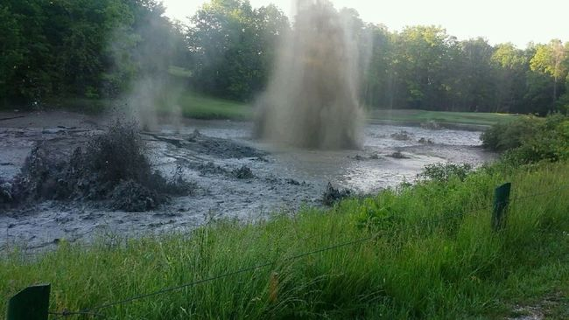
gas golf
https://g.solidity.cc/
https://thegolfnewsnet.com/golfnewsnetteam/2015/06/23/video-methane-gas-erupts-golf-water-hazard-11631/

Slide 43
eth units
public static class Unit { public static BigInteger Wei = 1; public static BigInteger GWei = 1000000000; public static BigInteger Szabo = 1000000000000; public static BigInteger Finney = 1000000000000000; public static BigInteger Ether = 1000000000000000000; public const string EthSymbol = "Ξ"; }

Slide 44
refunds
destroy : sclear

Slide 45
receipts : logs
https://codeburst.io/deep-dive-into-ethereum-logs-a8d2047c7371

Slide 46
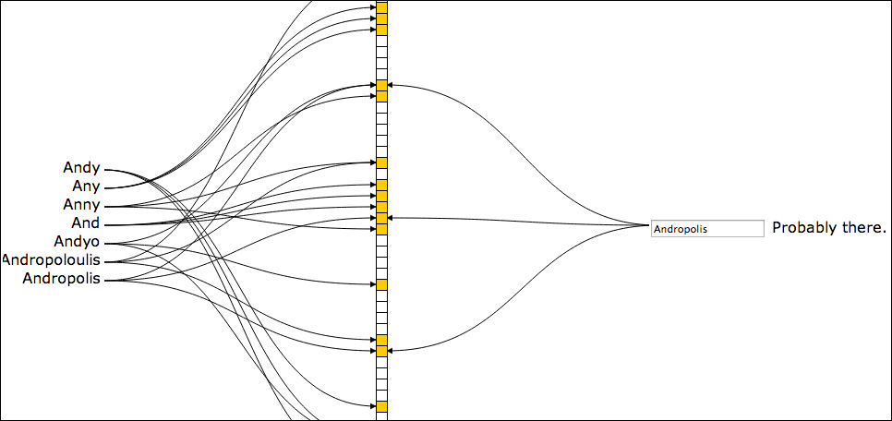
bloom filter
https://www.packtpub.com/mapt/book/big_data_and_business_intelligence/9781783281015/10/ch10lvl1sec51/understanding-how-bloom-filters-help-guesses

Slide 47
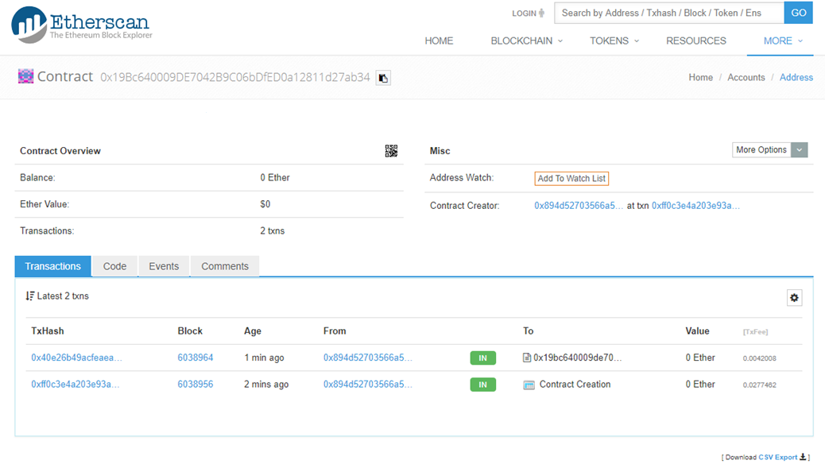
solidity contracts

Slide 48
difficulty

Slide 49
ommer : uncle
last block effect : network security : economics

Slide 50
DAO
Ethereum Classic

Slide 51
les
light client : bloom bits

Slide 52
par
warp sync

Slide 53
shh
Whisper

Slide 54
bzz
SWARM : IPFS

Slide 55
constantinople
EIP145 (shifts – SHL, SHR, SAR)
EIP1014 (CREATE2) : EIP1052 (EXTCODEHASH)
time bomb delay

Slide 56
sharding

Slide 57
plasma

Slide 58
beacon chain

Slide 59
eWASM
sentinel contract : WASM : EEI (eth env interface) : transpiler : metering

